Slide 1



TASK MASTER
ENHANCING TEAM PRODUCTIVITY
CAIRO UNIVERSITY | EGYPT | 2024

Slide 2
CONTENT
01
ABOUT US
02
MOTIVATION
03
PROBLEM STATEMENT
04
PROPSED SOLUTION
05
SYSTEM ARCHITECTURE
06
TECHNOLOGY TOOLS
07
COST
08
LIMITATIONS

Slide 3


ABOUT US
Abdelaziz Salah
Abdelrahman Hamza
Donia Gameel
Heba
Ashraf
Senior Computer Engineering student at Cairo University
Senior Computer Engineering student at Cairo University
Senior Computer Engineering student at Cairo University
Senior Computer Engineering student at Cairo University

Slide 4

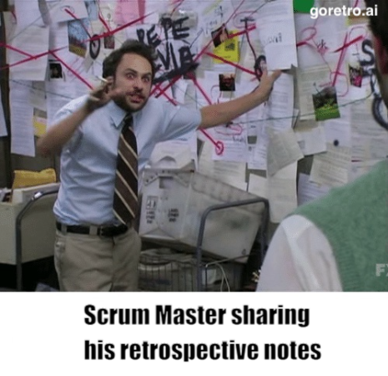
MOTIVATION
Sprint planning processes are time-consuming and prone to errors.
The proposed solution aims to address these challenges and improve team management processes.

Slide 5

PROBLEM STATEMENT
Manual task assignment processes are inefficient and error-prone.
Lack of automated tools leads to uneven work distribution and delays.
Managers struggle to assign tasks based on skills, workload, and availability.
Effort estimation is often overlooked, leading to inaccurate project planning.

Slide 6





PROPOSED SOLUTION
EFFORT ESTIMATION
FEEDBACK ANALYSIS
AUTOMATED TASK GENERATION
SKILL-BASED ASSIGNMENT

Slide 7
PROPOSED SOLUTION-1
Our proposed solution is a system that automates task assignment and management. It offers the following key features:
Automated Task Generation: The system takes a project description as plain text and generates tasks from it. This eliminates the need for manual task creation, saving time and reducing errors (GPT - API)
Effort Estimation: For each task, the system generates an estimated time, required skills, and difficulty level. This information is crucial for effective resource allocation and project planning.

Slide 8
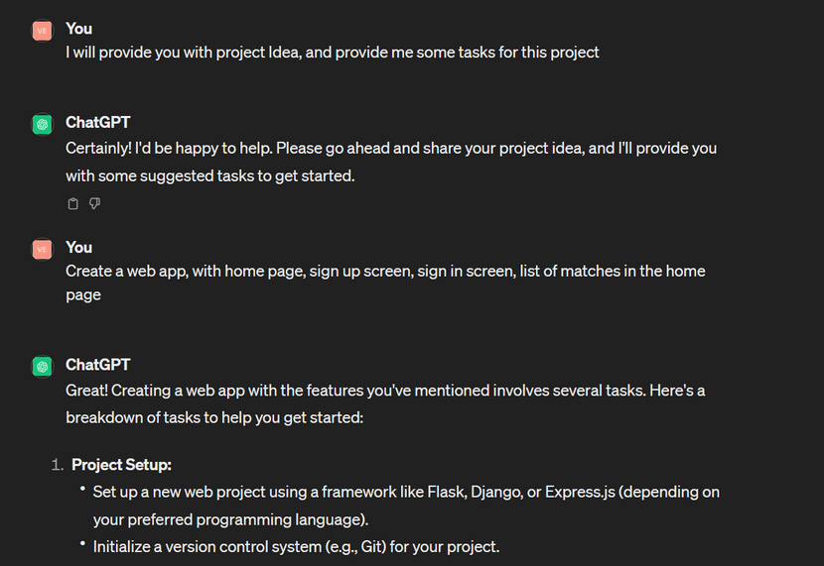
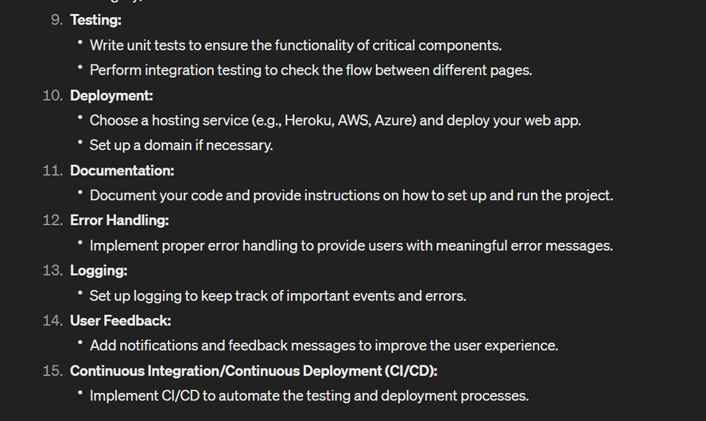
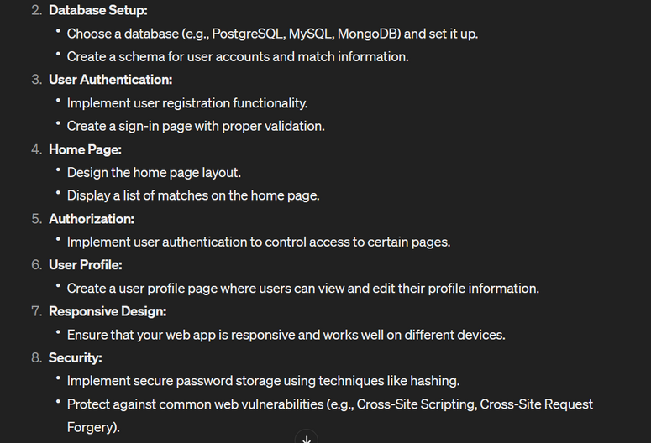
Screenshots for initial trials
Providing chatGPT with plaintext description for our project, and it provides us some tasks to implement.

Slide 9

Screenshots for initial trials
Asking ChatGPT to provide us with the required skills for doing certain task.

Slide 10
PROPOSED SOLUTION-2
Skill-Based Assignment: Tasks are automatically assigned to the most suitable employee based on their skills, workload, and availability. This ensures that each task is assigned to the most qualified team member.
Feedback Analysis: The system analyzes human feedback on task completion to improve the accuracy of time and skills estimation. This continuous improvement loop ensures that the system becomes more effective over time (Vader)

Slide 11
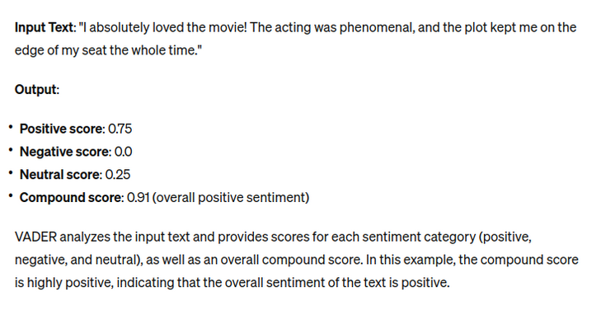
Screenshots for initial trials
Asking Vader to analyze the provided feedback!
"VADER" stands for Valence Aware Dictionary and sEntiment Reasoner. It's a lexicon and rule-based sentiment analysis tool that is specifically tuned to sentiments expressed in social media. VADER analyzes text to determine the emotional intensity (positive, negative, or neutral) of the sentiment expressed within it.

Slide 12

DEEP INTO THE TECHNICAL DETAILS...

Slide 13
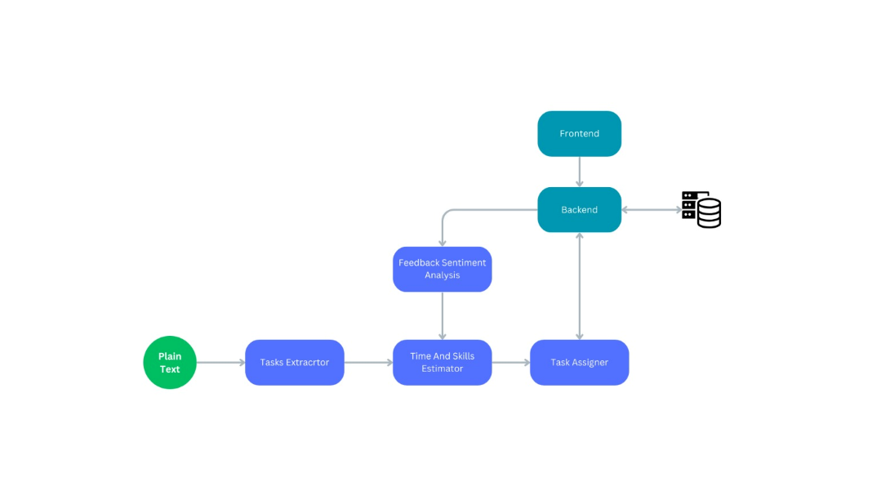
SYSTEM ARCHITECTURE

Slide 14

ON ANY FAILURE
Vader comes to play
Whenever any Employee fails in finishing his task in the estimated time, he must provide the system a feedback, explaining his reasons.​
This will be used to analyze the environment and enhance the predictions of the model if many employees complain from the same problem.
Also, we could keep them in a log, so any supervisor can have a look at them, and try to understand and evaluate the situation.

Slide 15

REWARD & PUNISHMENT
We Suggest a fair way in rewards and punishments, and both are based on the nature of the provided task.
Each Task is assigned based on some equation using the required skills for this task.
So, we should have three main factors​
- Constant reduction factor (CRF).​ - Quality Factor (QF)
- Importance of each skill factor (ISF).​
Then we add/deduce points from each skill using the following equation​
- Reduction -= CRF * QF * ISF​ - Bonus += CRF * QF * ISF​

Slide 16

ESTIMATED COST
Number of needed engineers:
- 2-3 backend developers
- 2-3 frontend developers
- 1-2 testers
- 3-4 machine learning engineers
Resources needed:
- GPUs: 2-3
- Servers: 1
- Machines: 1 for each developer
Data gathered from companies
Time for the system building & testing
- About 3-4 months
Time for the system maintenance
- About 2 months

Slide 17







TECHNOLOGY STACK & TOOLS
PyTorch

Slide 18




LIMITATIONS
ACCURACY OF TASK EXTRACTION
SKILL MATCHING
EXTERNAL FACTORS
OVERSIMPLIFICATION

Slide 19

LIMITATIONS
Oversimplification: The Provided task is very simple, so no clear way to be able to extract the tasks.
Skill Matching: Automatically determining employee skills and matching them to tasks can be inaccurate. It might not account for experience, motivation, or dynamic team relationships.
External Factors: Personal Problem, Unexpected events, etc...

Slide 20
THANK YOU

